Slide 1
Biomarker Analysis - Complexity Measurements
Dr. Sepideh Hajipour - Dr.Maryam Mirian
Mohamad Hosein Faramarzi - Dear teammates :)

Slide 2
The assumption of complexity in EEG signals for Parkinson's Disease (PD)
Neural activity in the brain becomes less complex as the disease progresses
Increased synchronization: Excessive synchrony in brain oscillations, particularly in the beta band.
Loss of multiscale complexity: Reduced dynamic behavior across different time scales.
What is the best way to evaluate this assumption?

Slide 3
Entropy Measurements
Entropy quantifies the randomness or unpredictability of EEG signals.
Higher entropy values generally correspond to more random, less predictable behavior
Approximate Entropy (ApEn)
Sample Entropy (SampEn)
Permutation Entropy (PE)

Slide 4
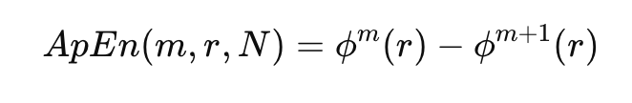
Entropy Measurements - Approximate Entropy (ApEn)
Degree of unpredictability or randomness in a signal
ApEn is then calculated using the ratio of the number of similar patterns in the series for 𝑚 and 𝑚+1
The difference between the probabilities for m and m+1 helps measure the likelihood that patterns of length m will remain similar when extended to length m+1.

Slide 5
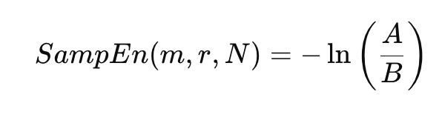
Entropy Measurements - Sample Entropy (SampEn)
A modification of Approximate Entropy (ApEn)
A is the number of similar patterns of length m+1.
B is the number of similar patterns of length mmm.
N is the length of the time series.

Slide 6
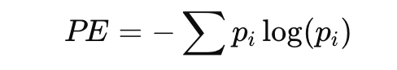
Entropy Measurements - Permutation Entropy (PE)
PE analyzes how values in a time series are ordered relative to each other
pi​ is the probability of the iii-th ordinal pattern.

Slide 7
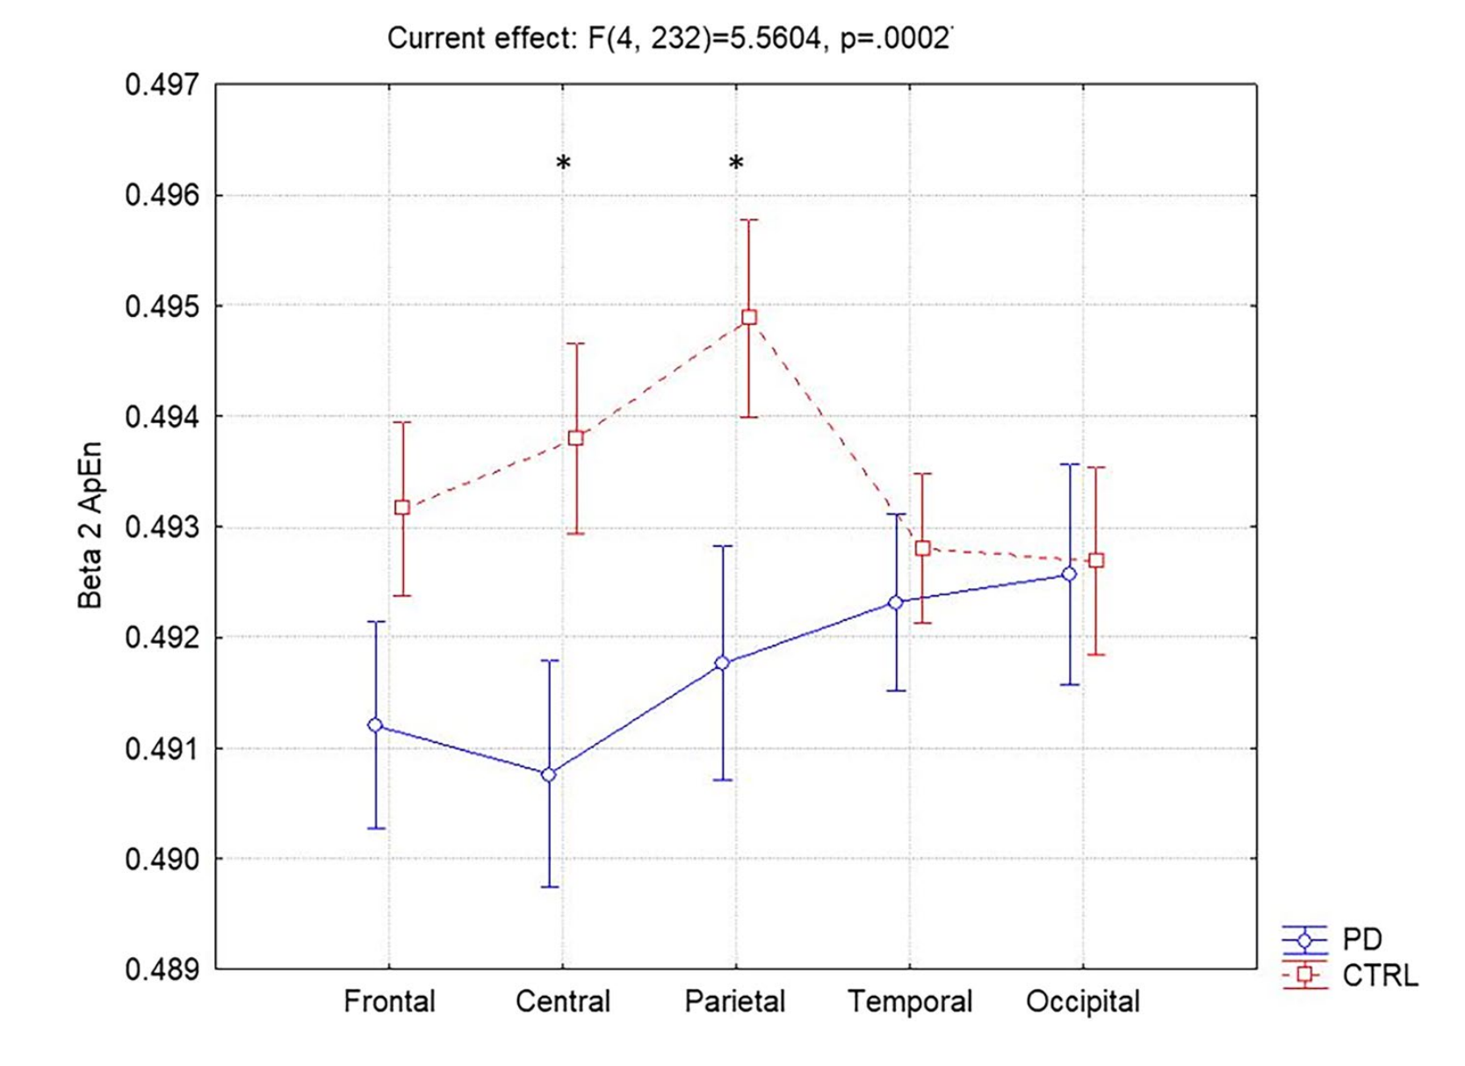
Previous Results
Exploring the complexity of EEG patterns in Parkinson’s disease Lorenzo Nucci · Francesca Miraglia · Chiara Pappalettera · Paolo Maria Rossini · Fabrizio Vecchio
Paper published 2023
A total of 60 participants
the CTRL group of healthy subjects (n=35)
and the PD of Parkinson’s patients (n=25)

Slide 8
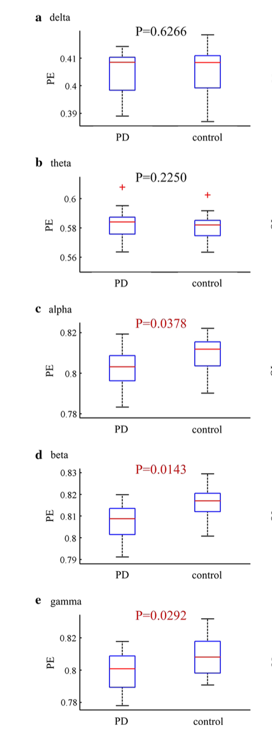
Previous Results
Complexity of resting-state EEG activity in the patients with early-stage Parkinson’s disease
Paper published 2017
18 healthy subjects
18 PD patients

Slide 9

Antropy Library for complexity measurement
AntroPy is a Python 3 package providing several time-efficient algorithms for computing the complexity of time-series. It can be used for example to extract features from EEG signals.
BSD 3-Clause License Copyright (c) 2018-2021, Raphael Vallat All rights reserved.

Slide 10
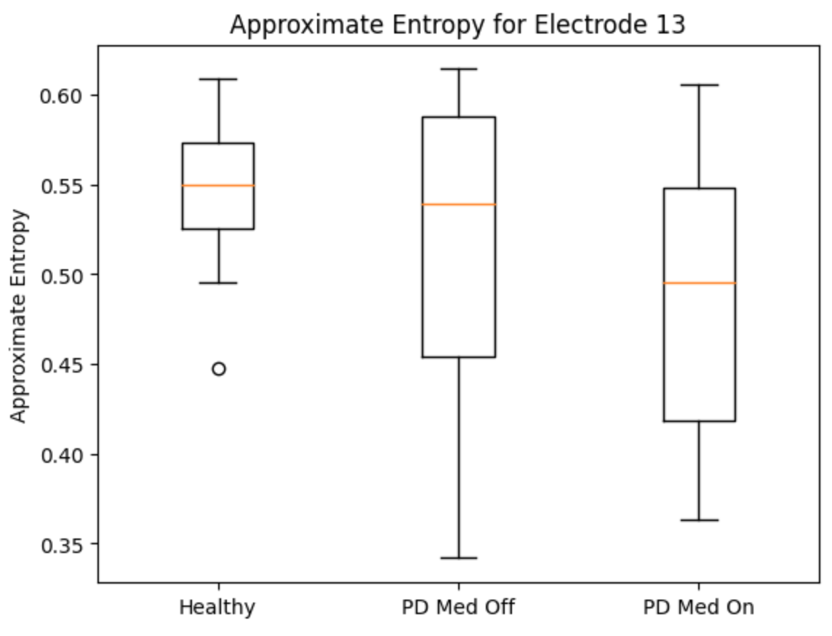
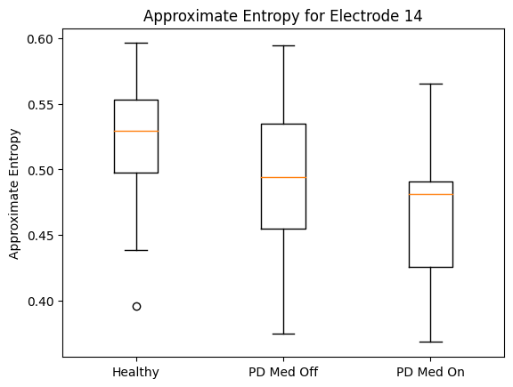
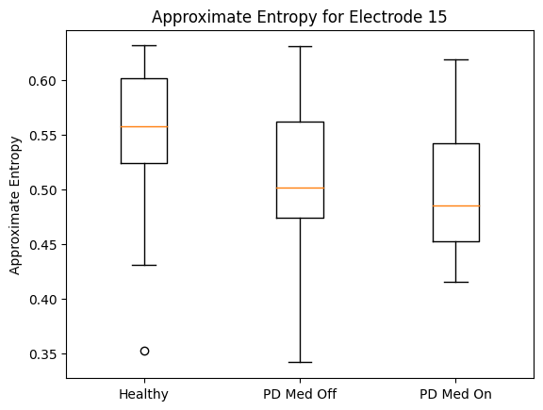
New Results - Approximate entropy
Results for central electrodes

Slide 11
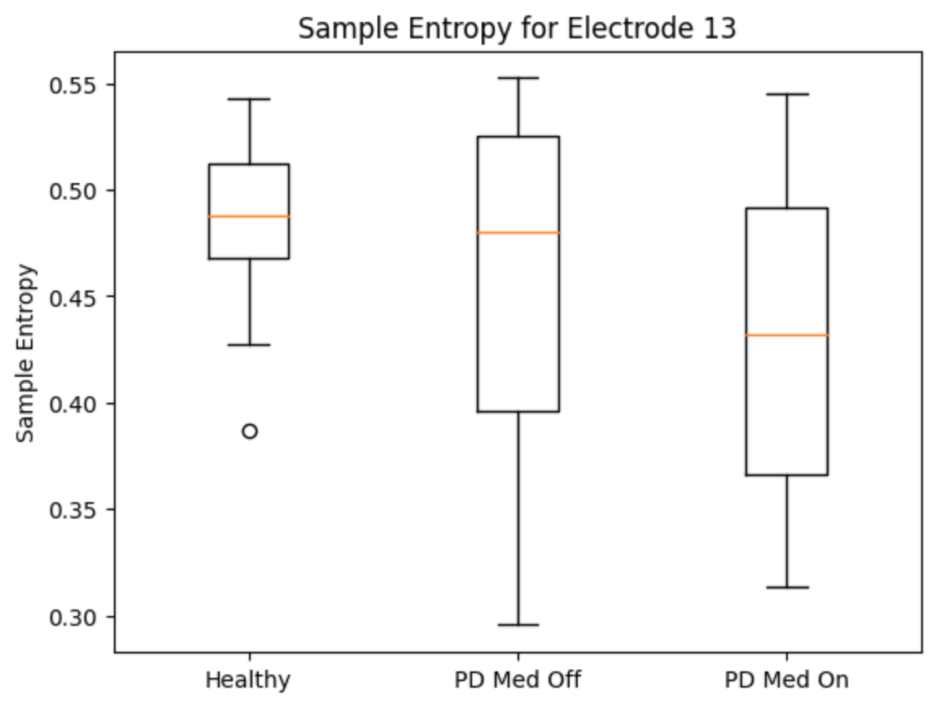
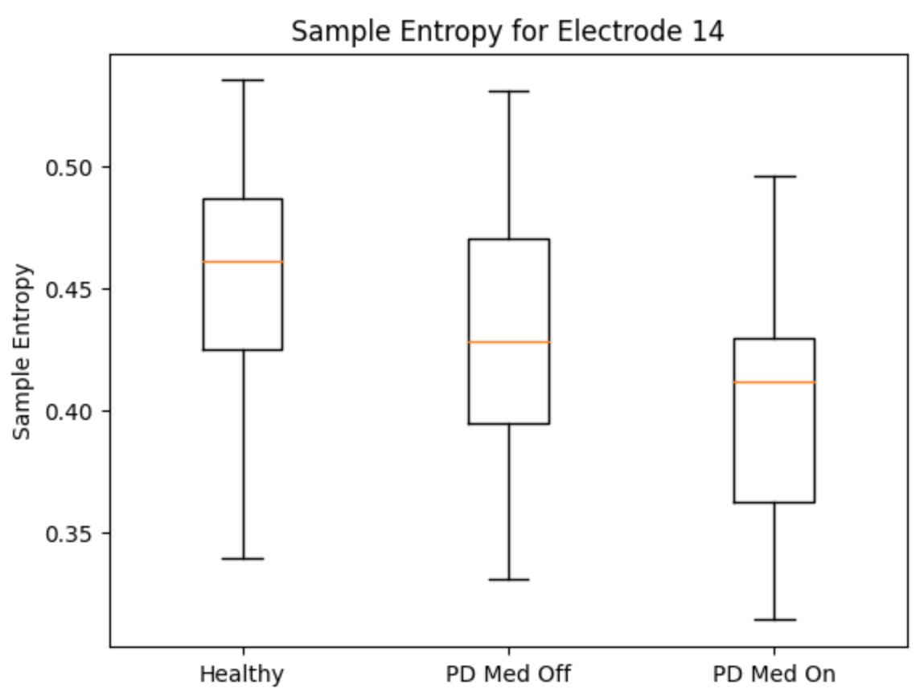
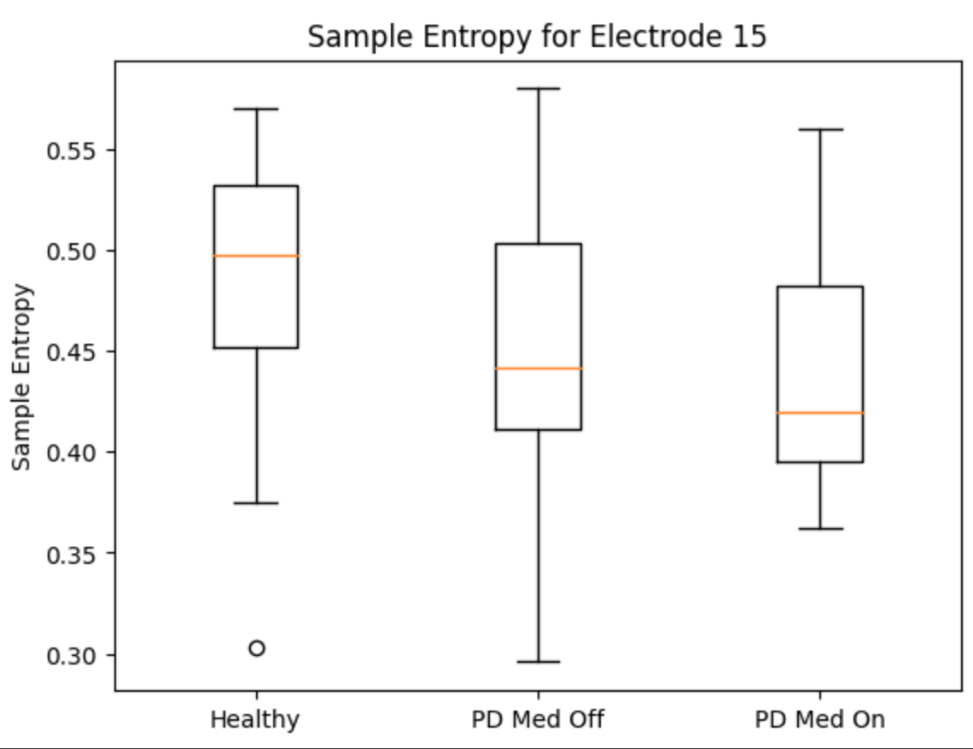
New Results - Sample entropy
Results for central electrodes

Slide 12
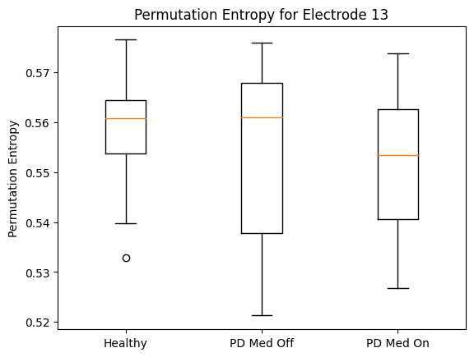
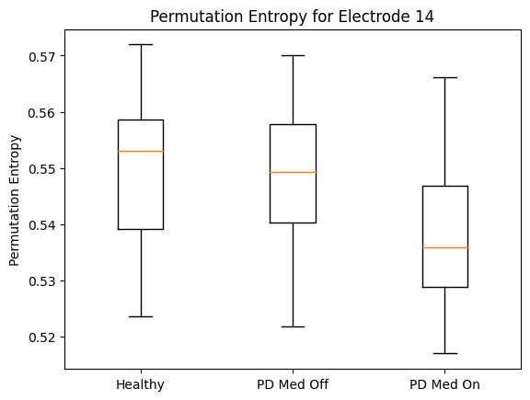
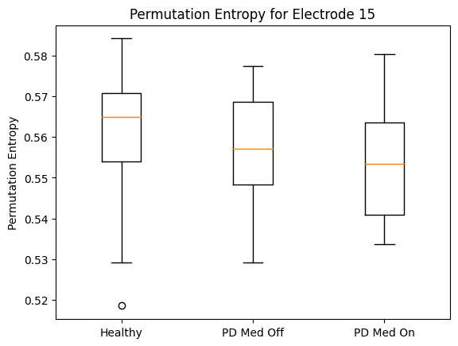
New Results - Permutation Entropy
Results for central electrodes

Slide 13


